Slide 1
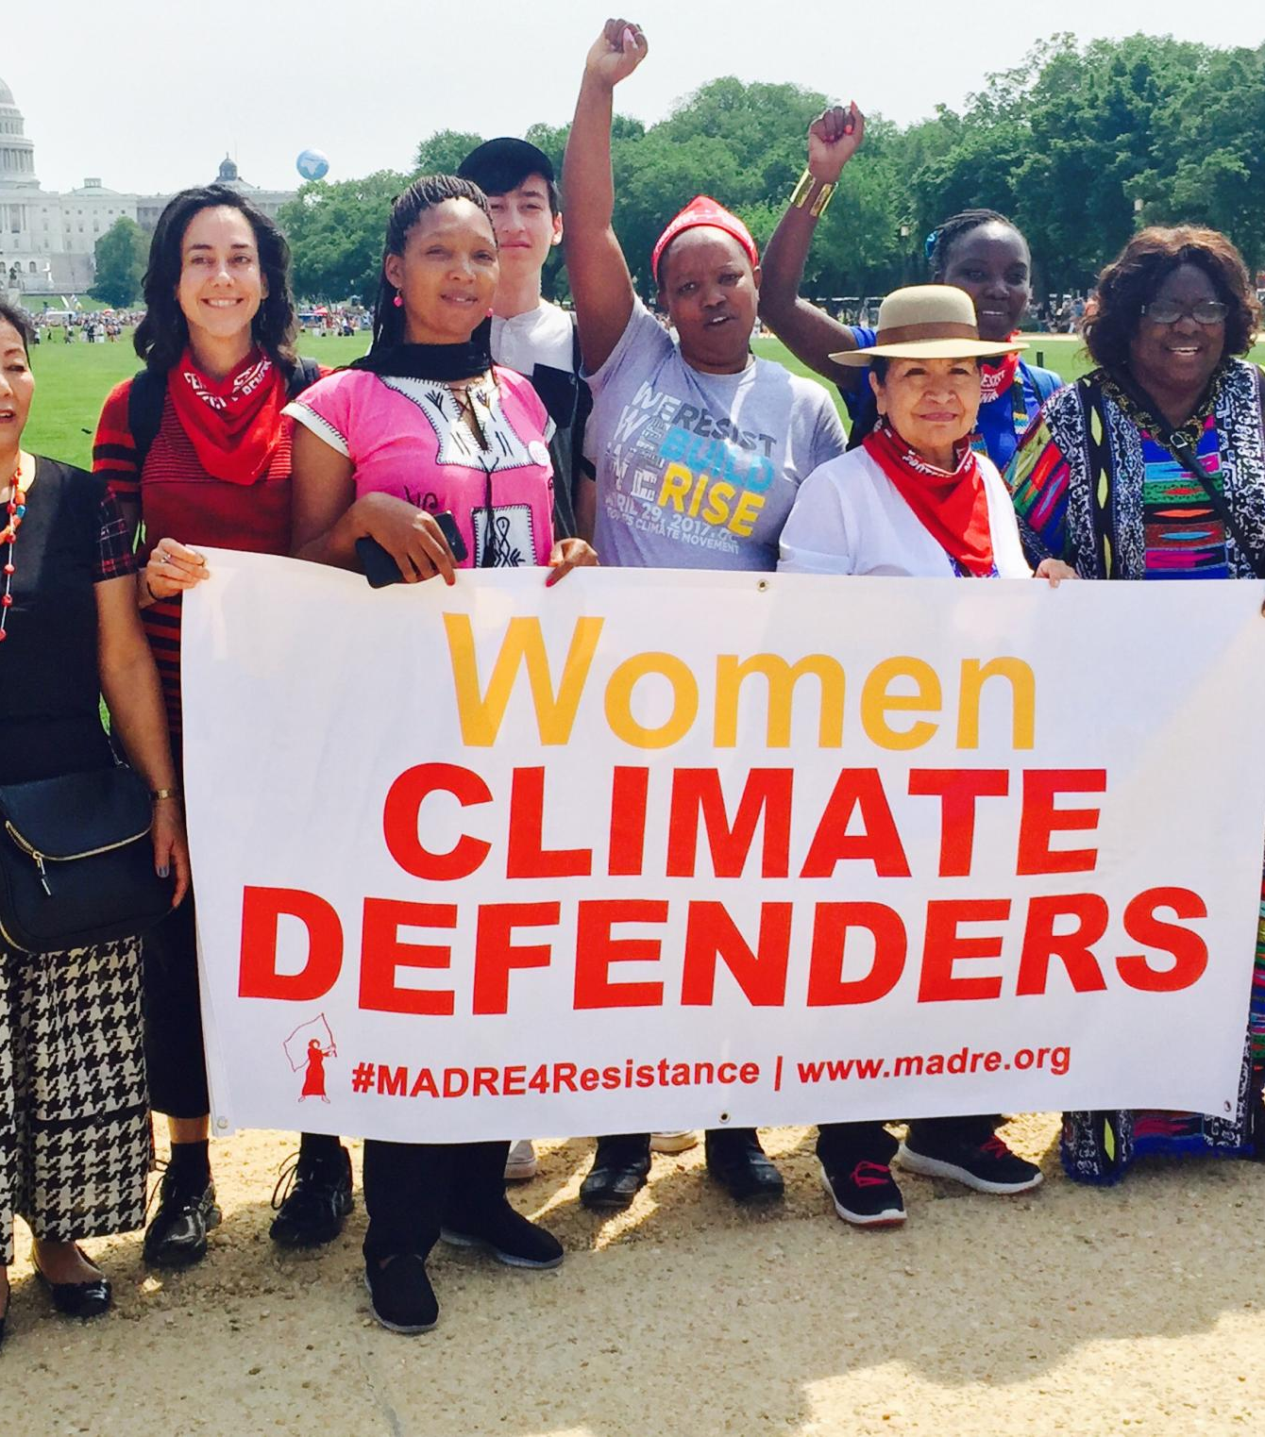
Name:
Women & Environmental Conservation
Course & Date
Do women have stronger pro-climate beliefs and views?
Is pollution a gendered issue
in society today?
How can women take more active roles in environmental conservation?
For example, working women have to care for sick babies due to pollution-related issues.
Women are more disadvantaged arising from pollution than men (Montt, 2018).
Shape conservation culture
Participate in conservation initiatives
Women are crucial partners in conservation culture & activities
(Koohi et al.2014)
Yes!
- Women, more than men have stronger views and beliefs in favor of environmental conservation.
Women not only present more assessed scientific knowledge but also slightly higher concern to conservation than men (McCright, 2010).

